Slide 1

Final Year Project Presentation On WAKEGUARD: DROWSINESS DETECTION & ALARM SYSTEM
Presented by: Guided by:
Archana Chawala (CSE/20/10) Dr. Rajat Subhra Goswami
Gaurav Dev (CSE/20/25) Associate Professor
Shivani Agrawal (CSE/20/36) Dept. of CSE
NIT Arunachal Pradesh

Slide 2
Topics Of Discussion
Introduction
Problem Statement
Motivation
Objective
Literature Review
Methodology
System Requirement Specification
System Architecture
Implementation
Results and Discussions
Conclusion
Future Scope and Limitations

Slide 3
Introduction
In today’s time, India experiences around 1200 road accidents everyday on an average.
The root cause of these occurrences is fatigue brought on by the lack of sleep.
To solve this issue, we have developed a drowsiness detection system named “WakeGuard” to enhance the safety measures.
It is based on advanced facial landmark mapping and deep learning techniques.
The main aim is to not only save lives but also contribute to overall public safety and well-being.

Slide 4
Problem Statement
Development of an effective and efficient drowsiness detection system that relies on non-intrusive image processing techniques to analyse facial features, particularly focusing on eye behaviour (blinking patterns) is the need of the hour.

Slide 5
Motivation
As we know, conventional methods, such as public awareness campaigns and scheduled rest breaks, have not been fully effective in mitigating this risk.
The emergence of advanced technologies offers the potential to develop more robust solutions capable of real-time drowsiness detection and intervention. Utilizing artificial intelligence, machine learning, and multimodal sensing technologies, we can create systems that greatly enhance road safety.
This project is motivated by the pressing need to reduce accidents related to driver fatigue and to improve overall traffic safety through innovative and dependable detection systems.

Slide 6
Objective
To develop a reliable drowsiness detection system that actively monitors driver alertness, provides timely alerts, and reduces the incidence of road accidents caused by driver fatigue, thereby improving overall road safety and promoting the well-being of drivers.
To develop and optimize image preprocessing techniques to accurately isolate and enhance relevant facial features under varying lighting and environmental conditions, ensuring robust performance of the drowsiness detection system.
To design a prototype for drowsiness detection using Raspberry Pi and Dlib implementation.

Slide 7
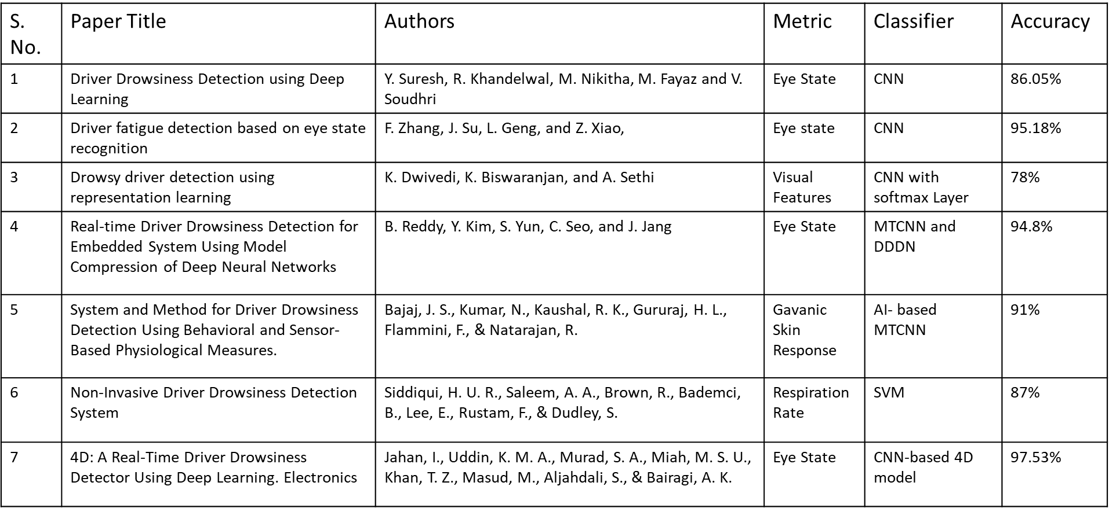
Literature Review

Slide 8
Methodology
In this project, we have used two methods to detect the drowsiness of a driver:
Using Deep Learning based Implementation
Using Dlib based Implementation

Slide 9
Deep Learning based Implementation
The following steps are used to implement different deep learning models:
Dataset Preparation: Used MRL Eye Dataset to obtain open and closed eye images.
Image preprocessing: Scaling, Normalization and BGR2GRAY conversion.
Model Training: Leveraged CNN models like Inception V3, ResNet, VGG19, MobileNet for tasks like image recognition and classification.

Slide 10
Testing: The model is evaluated on a distinct test dataset to assess its generalizability and performance post-training.
Detection of Unknown Images: After training, the accurate model uses the Haarcascade frontal detector to identify and crop the facial region to extract eye images for detecting eye states in unknown images.
Eye State Classification: Using the trained model, the system identifies the eye state (awake/sleepy) using learned patterns and attributes. If the drowsy state continues for particular time frames then the alarm is activated.

Slide 11
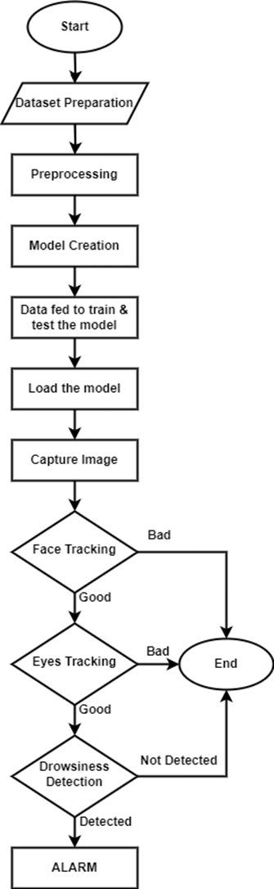
Flowchart illustrating deep learning based implementation

Slide 12
Dlib based Implementation
Camera Interface Setup: The proposed model begins with OpenCV-generated camera interface, activating and capturing images.
Image Processing: Identify 68 face landmarks using Dlib shape predictor from collected photos to determine Eye Aspect Ratio (EAR) and locate eye regions.
Detection of Drowsiness: System triggers alarm if EAR remains below threshold for consecutive frames, sounding buzzer and displaying alert message.
System Reaction: The system will continue taking pictures discreetly while keeping an eye out for any indications of sleepiness if it does not discover any.

Slide 13
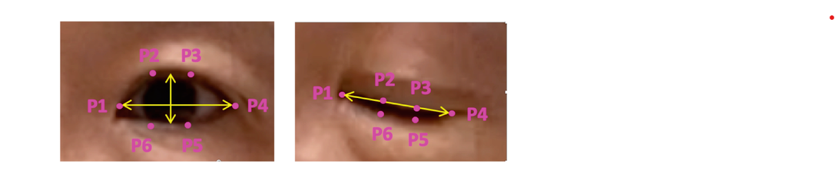
EAR Calculation
Using frontal face detector of Dlib, a sequence of 68 facial landmarks points is mapped.
From these 68 points, our region of interest i.e. eye points are extracted.
Eye landmarks for the EAR Calculation

Slide 14
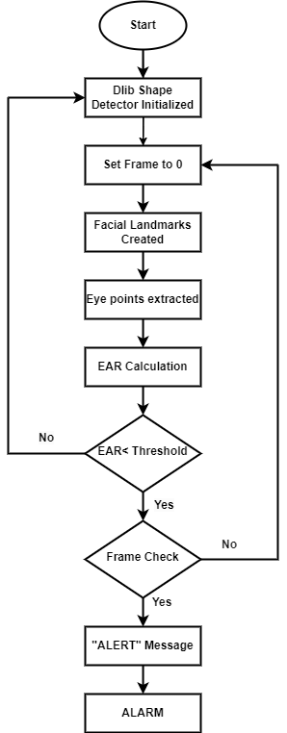
Flowchart illustrating dlib based implementation

Slide 15
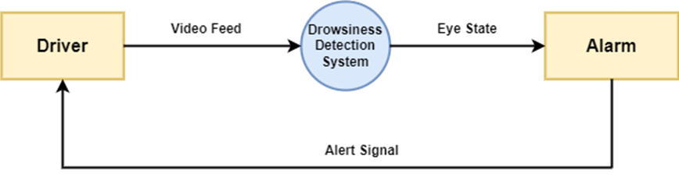
Data Flow Diagram
Data Flow Diagram: Level 0

Slide 16
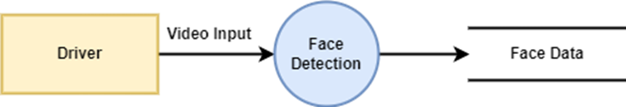
Data Flow Diagram: Level 1

Slide 17
Software Requirements Specifications
Hardware Requirements:
Raspberry Pi 3
Camera
Buzzer
Cooling-Fan
Monitor
Mouse
Keyboard
Ethernet LAN
Jumper wire
SD Card (64GB)

Slide 18
Software Requirements:
Operating System : Raspbian [32-bit, Kernel Version- 6.6, Debian Version- 12]
Programming Language : Python 3.13
Deep Learning Framework : TensorFlow 2.16.1
Shape detector: Frontal & Haar Cascade Face Detector
Deep Learning Models: Inception V3, ResNet, VGG19, MobileNet
Library: OpenCV, Imutils, Dlib
IDE : Anaconda 2023.09

Slide 19
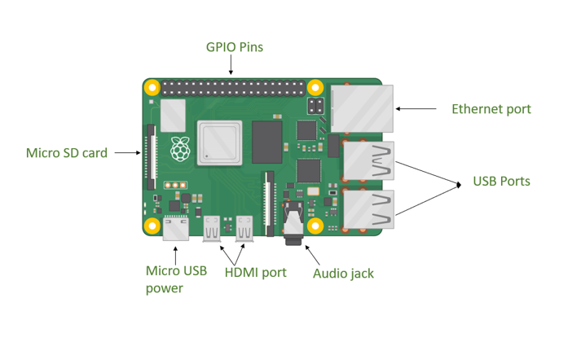
System Architecture
Raspberry Pi Architecture

Slide 20
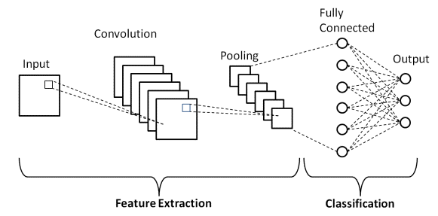
CNN Architecture

Slide 21
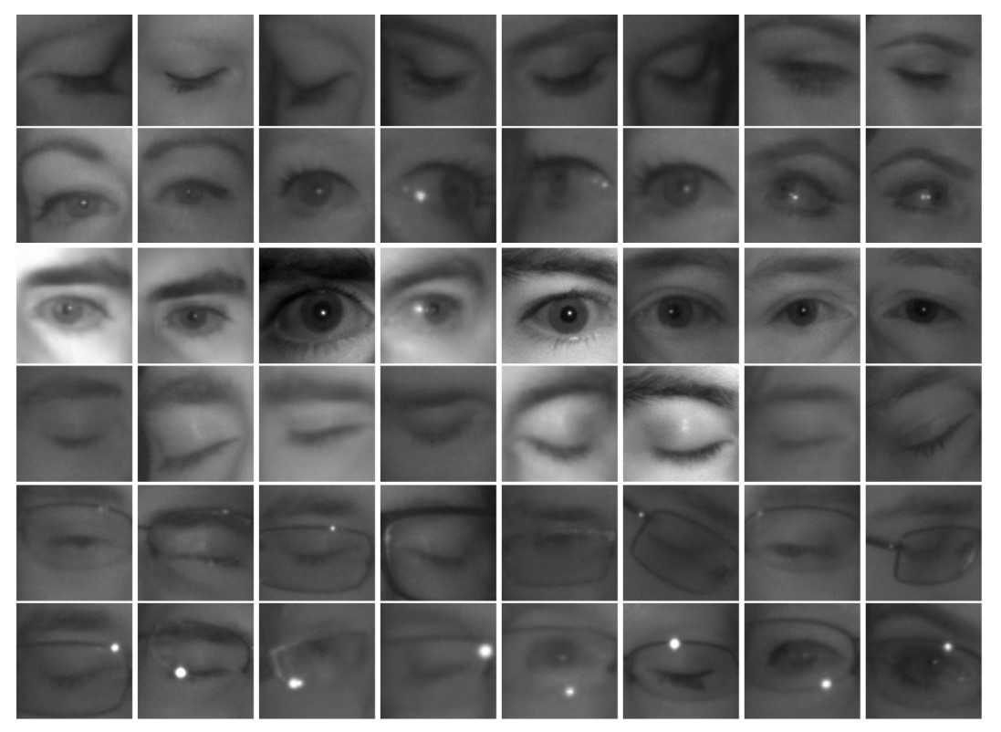
Deep Learning Based Implementation
1. Dataset Preparation: Used MRL Eye Dataset to obtain open and closed eye images and applied image preprocessing techniques like scaling, normalization and BGR2GRAY conversion.

Slide 22
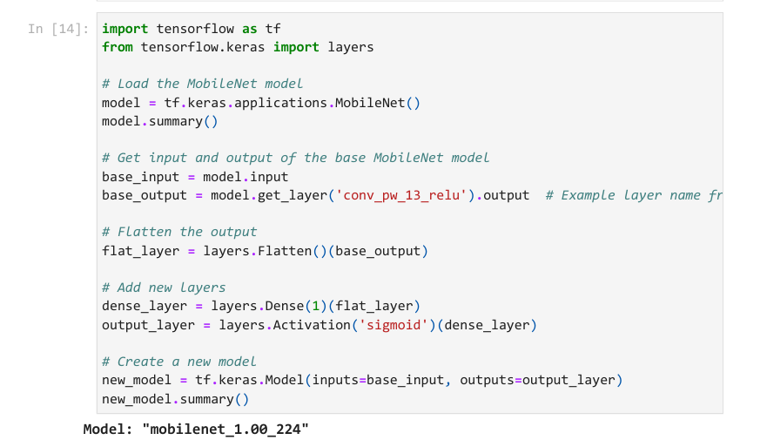
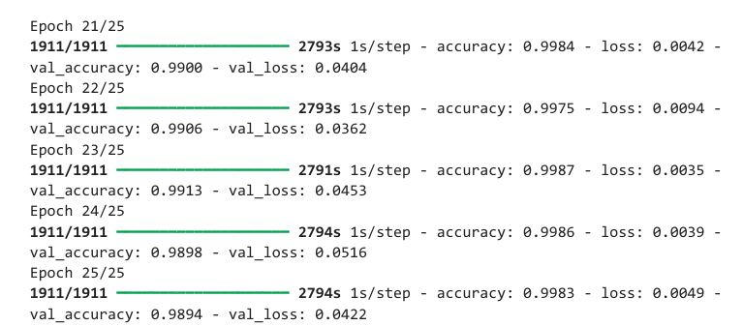
2. Model Training:
Model Creation Code
Model training

Slide 23
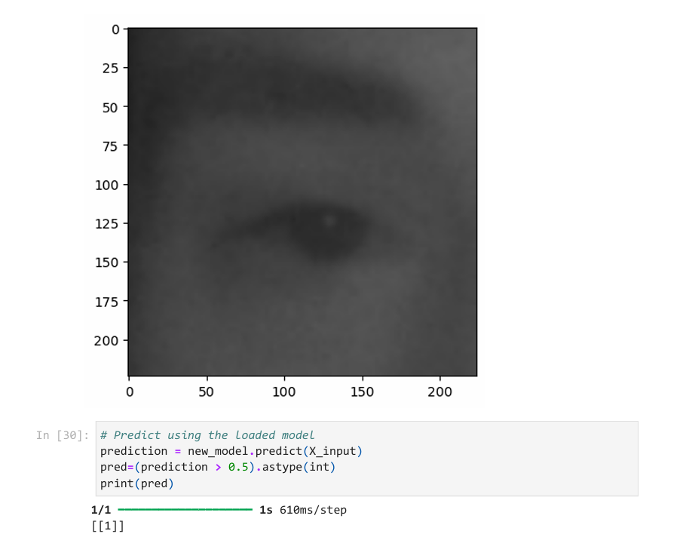
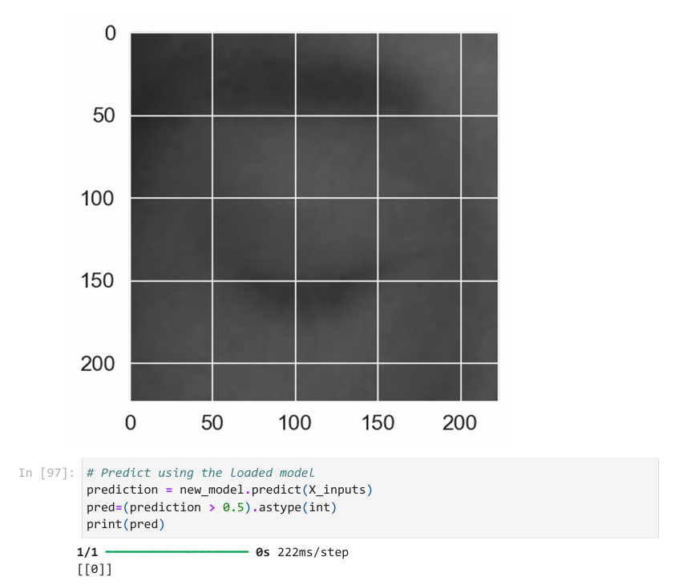
3. Model Testing
Open Eye State
Closed Eye Image

Slide 24
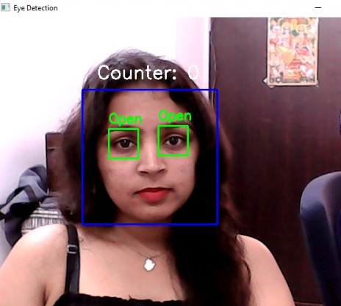
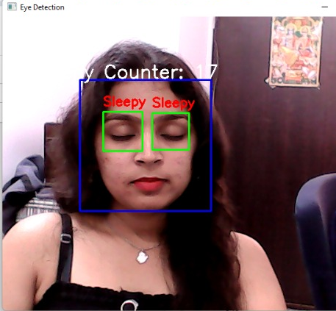
Drowsiness Detection by deep learning model in real time
Open Eye detected
Drowsiness detected

Slide 25
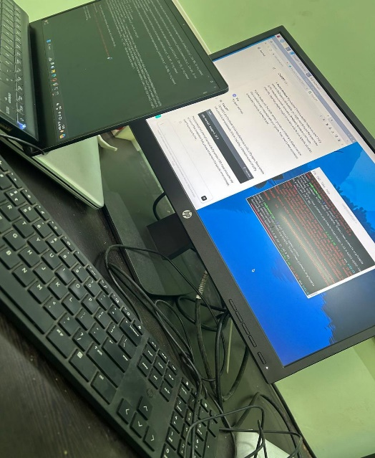
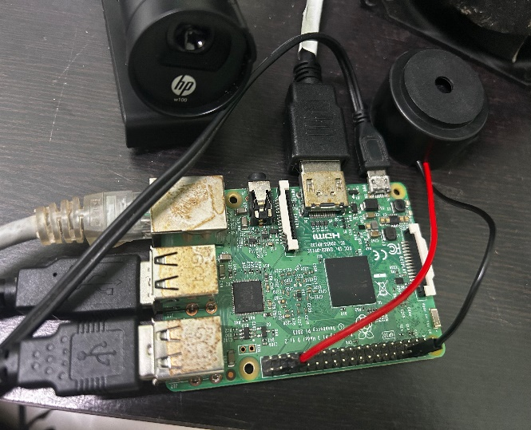
Dlib based Implementation
Camera Interface setup

Slide 26
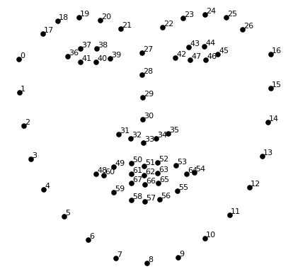
2. Landmark Detection
Sequence in which 68 facial landmarks are mapped on a detected face

Slide 27
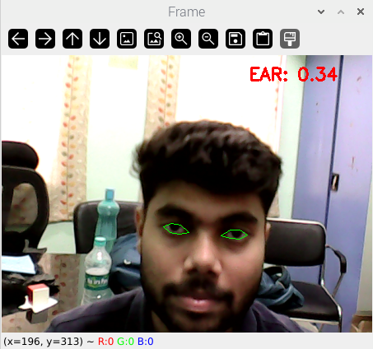
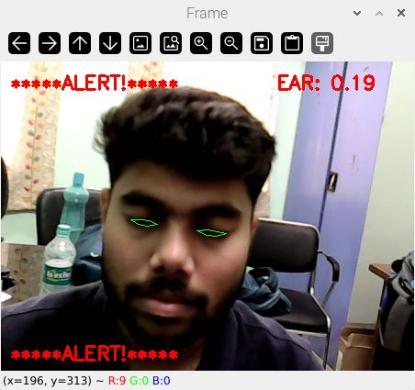
Drowsiness Detection by Dlib based model in real time
Open Eye detected, no alert generated
Closed Eye detected, alarm activated

Slide 28
Results & Discussions
Model Performance :
MODELS | ACCURACY
 | TRAIN ACCURACY | TEST ACCURACY
ResNet | 50.59% | 50.59%
VGG19 | 89.79% | 87.30%
Inception V3 | 98.29% | 97.72%
MobileNet | 99.89% | 98.78%

Slide 29
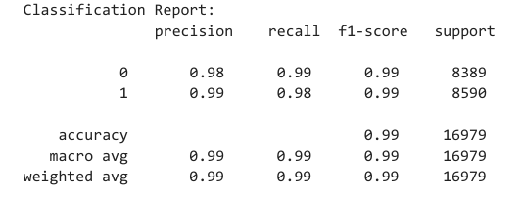
Classification Report :

Slide 30
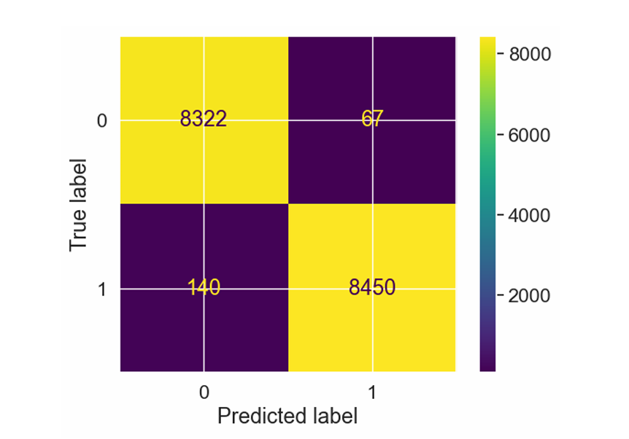
Confusion Matrix :

Slide 31
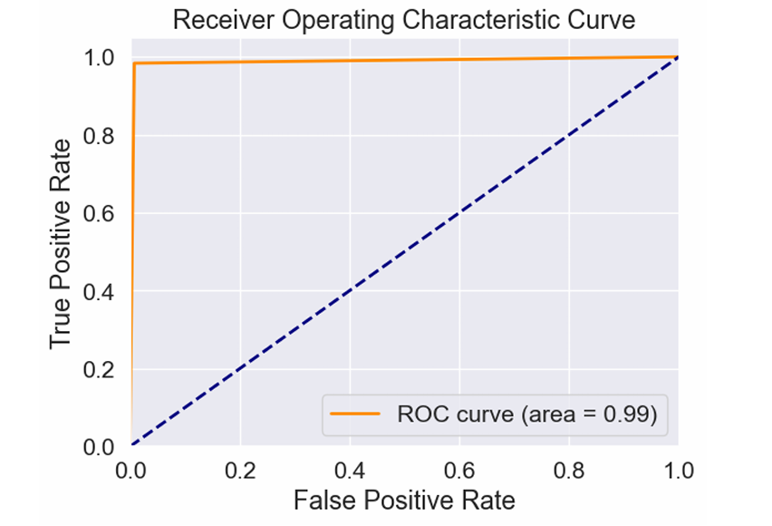
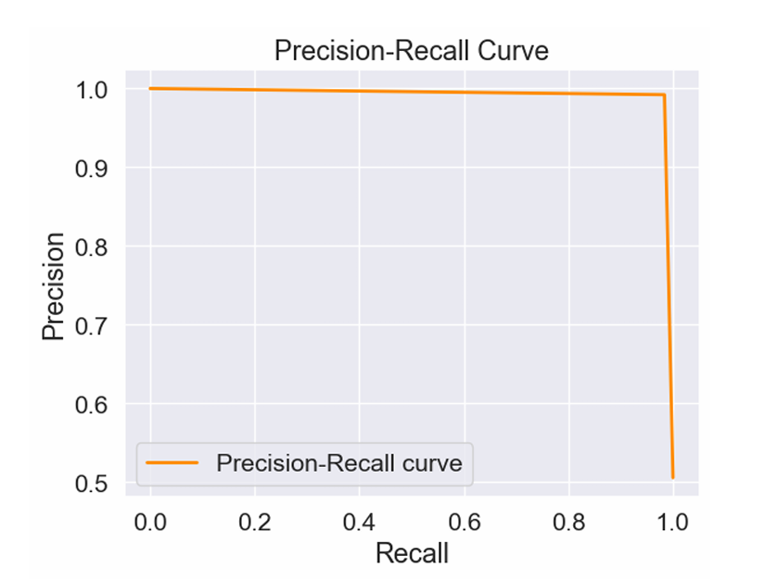
ROC Curve:
PR Curve:

Slide 32
Conclusion
A robust and non-invasive drowsiness detection system is developed using a combination of Dlib for facial landmark detection and Deep Learning using CNN technology for eye state classification.
It provides timely alerts to the driver whenever prolonged eye closure is detected.
The results from the evaluation show the effectiveness of the dlib and deep learning-based approach in real-world driving conditions and the system has achieved a satisfactory performance with 98.78% accuracy.
In this way, we have created a prototype “WAKEGUARD”, which aims to reduce the road accidents and enhance the safety measures.

Slide 33
Future Scope & Limitation
Environmental Adaptability: Develop systems that perform reliably under poor to mediocre lighting conditions.
More enhanced shape detector in the presence of glasses
Multimodal Sensing: Integrate diverse sensors (e.g., yawning, heart rate) for comprehensive monitoring.
Autonomous Vehicle Integration: Enhance safety by combining detection systems with autonomous driving technologies.

Slide 34
References
Deng, W., & Wu, R. (2019). Real-Time Driver-Drowsiness Detection System Using Facial Features. IEEE Access, 7, 118727–118738.
Gwak, J., Hirao, A., & Shino, M. (2020, April 22). An Investigation of Early Detection of Driver Drowsiness Using Ensemble Machine Learning Based on Hybrid Sensing. Applied Sciences, 10(8), 2890.
B. Warwick, N. Symons, X. Chen and K. Xiong, "Detecting Driver Drowsiness Using Wireless Wearables," 2015 IEEE 12th International Conference on Mobile Ad Hoc and Sensor Systems, Dallas, TX, USA, 2015, pp. 585-588, doi: 10.1109/MASS.2015.22.
Mehta, S., Dadhich, S., Gumber, S., & Jadhav Bhatt, A. (2019). Real-Time Driver Drowsiness Detection System Using Eye Aspect Ratio and Eye Closure Ratio. SSRN Electronic Journal.
Vesselenyi, T., Moca, S., Rus, A., Mitran, T., & Tătaru, B. (2017, October). Driver drowsiness detection using ANN image processing. IOP Conference Series: Materials Science and Engineering, 252, 012097.

Slide 35
Prashant Dhawde, Pankaj Nagare, Ketan Sadigale, Darshan Sawant, Prof. J. R. Mahajan, 2015, Drowsiness Detection System, INTERNATIONAL JOURNAL OF ENGINEERING RESEARCH & TECHNOLOGY (IJERT) ICONECT – 2015 (Volume 3 – Issue 06).
Driver Drowsiness Detection System Using Machine Learning. (2023, April 5). International Journal of Food and Nutritional Sciences, 11(12).
A. Mittal, K. Kumar, S. Dhamija and M. Kaur, "Head movement-based driver drowsiness detection: A review of state-of-art techniques," 2016 IEEE International Conference on Engineering and Technology (ICETECH), Coimbatore, India, 2016, pp. 903-908, doi: 10.1109/ICETECH.2016.7569378.
R. Lienhart and J. Maydt, "An extended set of Haar-like features for rapid object detection," Proceedings. International Conference on Image Processing, Rochester, NY, USA, 2002, pp. I-I, doi: 10.1109/ICIP.2002.1038171.
Vitabile, S., De Paola, A., & Sorbello, F. (2011, March 30). A real-time non-intrusive FPGA-based drowsiness detection system. Journal of Ambient Intelligence and Humanized Computing, 2(4), 251–262.
B. Bhowmick and K. S. Chidanand Kumar, "Detection and classification of eye state in IR camera for driver drowsiness identification," 2009 IEEE International Conference on Signal and Image Processing Applications, Kuala Lumpur, 2009, pp. 340-345, doi: 10.1109/ICSIPA.2009.5478674.

Slide 36
Danisman, T., Bilasco, I. M., Martinet, J., & Djeraba, C. (2013, June). Intelligent pixels of interest selection with application to facial expression recognition using multilayer perceptron. Signal Processing, 93(6), 1547–1556.
L. Li, Y. Chen and Z. Li, "Yawning detection for monitoring driver fatigue based on two cameras," 2009 12th International IEEE Conference on Intelligent Transportation Systems, St. Louis, MO, USA, 2009, pp. 1-6, doi: 10.1109/ITSC.2009.5309841.
Tanveer, M. A., Khan, M. J., Qureshi, M. J., Naseer, N., & Hong, K. S. (2019). Enhanced Drowsiness Detection Using Deep Learning: An fNIRS Study. IEEE Access, 7, 137920–137929.
R. Fusek, MRL Eye Dataset, Accessed on March 1, 2024. [Online]. Available: http://mrl.cs.vsb.cz/eyedataset
Chaudhari, Monali & Deshmukh, Mrinal & Ramrakhiani, Gayatri & Parvatikar, Rakshita. (2018). Face Detection Using Viola Jones Algorithm and Neural Networks. 1-6. 10.1109/ICCUBEA.2018.8697768.
Yogarajan, G., Singh, R. N., Nandhu, S. A., & Rudhran, R. M. (2023, September 29). Drowsiness detection system using deep learning based data fusion approach. Multimedia Tools and Applications, 83(12), 36081–36095.
Du, G., Long, S., Li, C., Wang, Z., & Liu, P. X. (2023, July). A Product Fuzzy Convolutional Network for Detecting Driving Fatigue. IEEE Transactions on Cybernetics, 53(7), 4175–4188.

Slide 37
Bajaj, J. S., Kumar, N., Kaushal, R. K., Gururaj, H. L., Flammini, F., & Natarajan, R. (2023, January 23). System and Method for Driver Drowsiness Detection Using Behavioral and Sensor-Based Physiological Measures. Sensors, 23(3), 1292.
Siddiqui, H. U. R., Saleem, A. A., Brown, R., Bademci, B., Lee, E., Rustam, F., & Dudley, S. (2021, July 15). Non-Invasive Driver Drowsiness Detection System. Sensors, 21(14), 4833.
Suhaiman, A. A., May, Z., & Rahman, N. A. (2020, September 27). Development of an intelligent drowsiness detection system for drivers using image processing technique. 2020 IEEE Student Conference on Research and Development (SCOReD).
Jahan, I., Uddin, K. M. A., Murad, S. A., Miah, M. S. U., Khan, T. Z., Masud, M., Aljahdali, S., & Bairagi, A. K. (2023, January 3). 4D: A Real-Time Driver Drowsiness Detector Using Deep Learning. Electronics, 12(1), 235.
Raspbian Set Up Library, Accessed on March 10, 2024. [Online]. Available: https://www.raspberrypi.com/software/operating-systems/
Dlib Library Installation, Accessed on March 10, 2024. [Online]. Available: http://dlib.net/
Harcascade Face Detector, Accessed on March 10, 2024. [Online]. Available: https://github.com/opencv/opencv/tree/master/data/haarcascades

Slide 38
THANK YOU

